Slide 1
Text Analysis of John Mulaney’s “New in Town”
By 2d Lt Maria Schroeder

Slide 2
Background
This text is from a stand-up comedy skit by John Mulaney
Both the words and captions of actions are included
Actions/descriptions are in () or []
Example: [Audience laughs]
What am I doing? I am applying text mining techniques in order to pull information from the chosen text in order to gain information about the text.
The techniques that will be used is still to be determined. I am unsure what my goal for this text is for now.
The use of sarcasm may be an obstacle

Slide 3
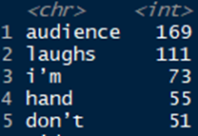
Progress
Text found and imported to R
Text split into individual words
Insights:
12,612 words
Most common word: “and”
Most common words not including stop words:
(unsure why “I’m” was included by the code)

Slide 4
Future Work
Find most used words (different stop word filter to find more meaningful words)/get rid
Create graphs
Use future techniques learned in class
Future technique applications to be determined.

